Slide 1
AZ-204: Develop Compute Solutions
Sergiy nagorny
Lead consultant
7 Sep 2023

Slide 2
Overview
Azure IaaS Solutions
Virtual Machines
Containers
Registry (ACR)
Instances (ACI)
Azure App Service Web Apps
Creating
Configuring
Scaling
Azure Functions
Function Triggers
Input and Output Bindings
Durable Functions
Custom Handlers

Slide 3
Provisioning and Configuring Azure Virtual Machines
VM Components
Resource Group
VM Size
Network
Images
Virtual Disk
Create VM Options
Azure Portal
Azure CLI (Demo)
Azure PowerShell
ARM Templates (Demo)
Azure REST API
Create VM in Azure Portal
Subscription
Resource Group
Name
Region
Availability (None, Zone, Set)
Image
Azure Spot instance
Size
Admin account
Inbound port rules (RDP)
Create VM Steps (Demo)
Create Resource Group
Create Virtual Machine
Enable Remote Access
Get Public IP Address

Slide 4
Understanding, Creating and Deploying ARM Templates
ARM Templates
JSON file defining resources
Building block for automation
Submitted to ARM for provisioning
Converted to REST API operations
Export from Azure Portal, Azure CLI, etc.
Deploy from Azure Portal, Azure CLI, etc.
Custom template (Demo)
Quickstart Template Library
ARM Template Format
"$schema": "https://schema.management.azure.com/schemas/2019-04-01/.deploymentTemplate.json#",
"contentVersion": "", // For user version control
"apiProfile": "", // For versioning resources in template
"parameters": { }, // Deployment values
"variables": { }, // Values reused in the template. Constructed from parameters
"functions": [ ], // Simplify template and allow code reuse
"resources": [ ], // Resources to be deployed
"outputs": { } // Return values from resources deployed
"dependsOn": [ ] // List of resources to be created before current resource.
"properties": { } // Resource properties

Slide 5
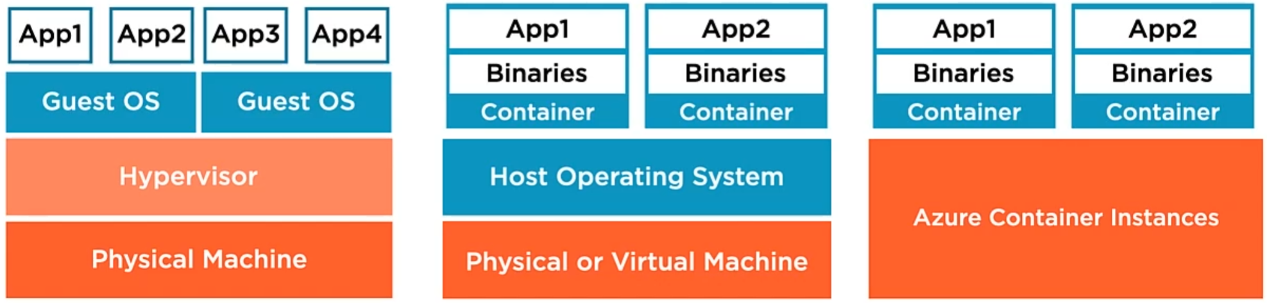
Creating and Running Containers in Azure
Container Fundamentals
Binaries, libraries and other components
Container image – binary application package
Container – running container image
One app inside the container
Generally, very small and very portable
Dramatically simplifies app deployment (start container)
Focus on Apps (build, configure, deploy)
Apps communicate via network
Tools and Services
Docker – Tools to create container
Azure Container Registry (ACR) – Store and manage containers
Azure Container Instances (ACI) – Run container with no Servers to manage
Compute PaaS (VM, OS)

Slide 6
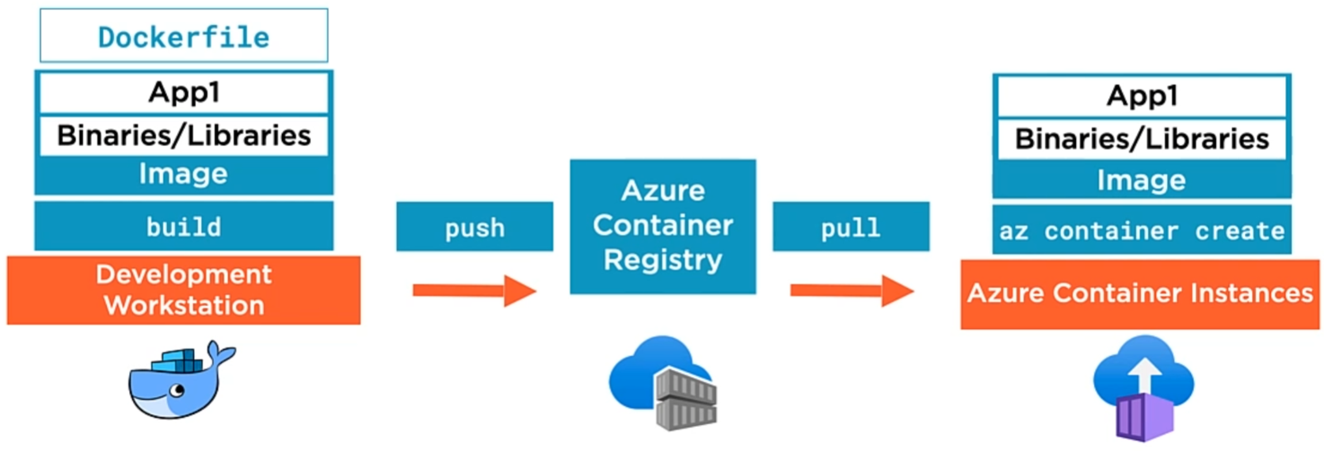
Creating and Running Containers in Azure
Build new image (Demo)
Development workstation
Docker tools
Dockerfile
Sequence of commands used to build a Container Image
Copy compiled App binaries into Container Image
Define with binary scripts to run when container is started from image
Push to ACR (Demo)
Upload container image
Share with:
Other users
Container orchestrators
Key component in a CI/CD pipeline
ACR Tasks for container image automation
Service tiers (Basic, Standard, Premium)
Pull from ACR (Demo)
Download container image
Create running container in ACI
Default: 1 vCPU, 1 GB RAM
Access Apps over internet via automatically provisioned FQDN
Optionally connect Apps to VNET (combine with ExpressRoute or VPN Gateway)
Use Azure Files for persistent storage (mounted File Shares backed by Azure Storage)
Define Restart policy - always, on failure and never
ACI is most affective for simple Apps, Task Automation, Build Jobs
Deployed in Groups (Share Host Machine, LAN, Storage and Lifecycle)
Combine Main App Container with Supporting Containers (e.g. Logging) to construct complex Apps
For Full Container orchestration use Azure Kubernetes Service

Slide 7
Creating Azure App Service Web Apps
Azure App Service
Http-based service for hosting web apps
Advanced version of web posting
Apps run and scale on Windows and Linux
Web app frameworks: AspNet, AspNetCore, NodeJs, Python, Php, etc.
Security, load balancing & automation
App Service web app runs under App Service Plan
VMs are behind App Service Plan
Managed by Microsoft in terms of patching, high availability, security, etc.
Costs use are determined by the App Service Plan
Two App Service Plan Types
Non-Isolated
Isolated
Non-Isolated Plan
Users access Web App over internet
Does NOT run in private VNET
Free and Shared Plans (F1, D1)
Run in shared infra with other customers and low spec resources
Not suitable for Prod (not secure or scalable enough)
Basic (B1, B2, B3)
Low traffic requirements
Don’t need advanced auto scaling or traffic management features
For more robust Dev and Test scenarios
Standard (S1, S2, S3)
For Production workloads
Pricing based on number of instances running
Start with S1 and scale-up as needed
Premium v2/v3 (P1v2 - P3v3)
Enhanced performance for Production web apps
Isolation with App Service Environments (ASE)
Fully isolated and dedicated environment for running web apps
Still managed but dedicated to you to make part of private VNET
Designed for high scale, high memory utilization (if Non-Isolated isn’t enough for Production)
Isolation and secure network access
Fine-grained control over network traffic (i.e. Network Security Groups)
Apps can connect over VPN to on-premises resources
On-premises Apps can communicate with your Web App running in ASE

